Slide 1
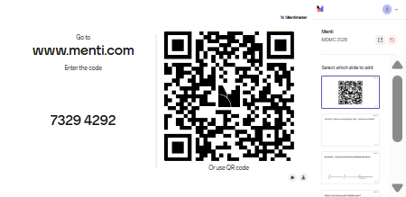
Mentimeter slide

Slide 2
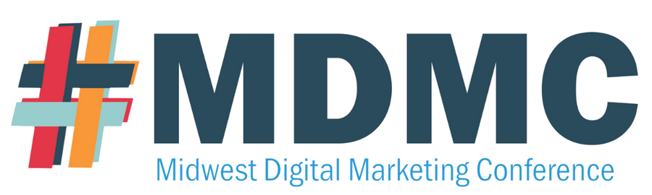

THE PERFECTION TRAP
How To Stop Overthinking and Start Creating
Danielle Oser
Learning Designer, Maryville University
@danielleoser · #perfectiontrap · #MDMC26

Slide 3


Slide 4



QUICK SHOW OF HANDS… How many of you have something unfinished right now?
#MDMC26

Slide 5
WE’RE NOT STUCK We’re stalling
#MDMC26

Slide 6
We tell ourselves we’re polishing… But really, we’re avoiding
#MDMC26

Slide 7
THE TRAP Perfectionism looks like productivity
#MDMC26

Slide 8
But nothing is actually MOVING FORWARD
#MDMC26

Slide 9
PERFECTIONISM = Avoiding the Next Decision
#MDMC26

Slide 10
You’re not stuck on perfect… You’re stuck deciding

Slide 11
WHEN YOU’RE SPINNING What’s driving it?
#MDMC26

Slide 12
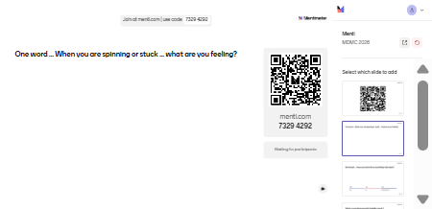
When you are spinning or stuck what is driving you?

Slide 13
WHY DO WE DO THIS? Pressure - Fear - Control
#MDMC26

Slide 14
WHAT ARE YOU AVOIDING?
#MDMC26

Slide 15
IT’S ONLY … One … Little … Quick Tweak
#MDMC26

Slide 16
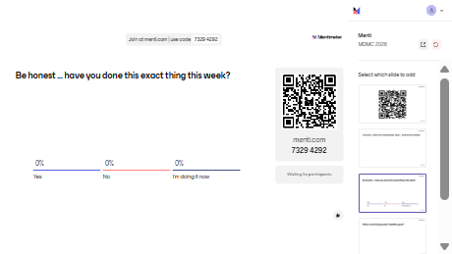
Be honest ... have you done this exact thing this week?
#MDMC26

Slide 17
SO HOW DO YOU MOVE FORWARD? Start ugly and Lower the bar
#MDMC26

Slide 18
NOTHING IS ORIGINAL Everything is a remix
#MDMC26

Slide 19
YOU CAN’T EDIT A BLANK PAGE… And you can’t improve something that doesn’t exist
#MDMC26

Slide 20
PERFECT IS NOT THE GOAL Perfect delays… Done moves
#MDMC26

Slide 21
THE COST What has trying to get it right cost you?
#MDMC26

Slide 22
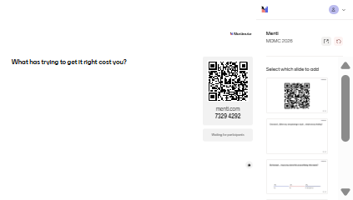
What has trying to get it right cost you?

Slide 23
THE REAL COST? Ideas sit too long Works slows down Teams overthink Confidence drops
#MDMC26

Slide 24
While we’re waiting… Nothing moves
#MDMC26

Slide 25
What’s sitting unfinished for you right now?
#MDMC26

Slide 26
Unfinished work follows you… It takes up space
#MDMC26

Slide 27
THE PATTERN Refine Overthink Avoid Restart
#MDMC26

Slide 28
THE PERFECTION LOOP Idea Doubt Overwork Delay Restart
#MDMC26

Slide 29
WAIT FOR PERFECT Wait forever
#MDMC26

Slide 30
Make a smaller decision… Define the next version Done > Perfect
#MDMC26

Slide 31
PROGRESS LOOP Idea Start Rough Get Feedback Adjust
#MDMC26

Slide 32
The difference isn’t talent… It’s tolerance for imperfect action
#MDMC26

Slide 33
UNFINISHED ≠ FAILURE It’s part of the process
#MDMC26

Slide 34
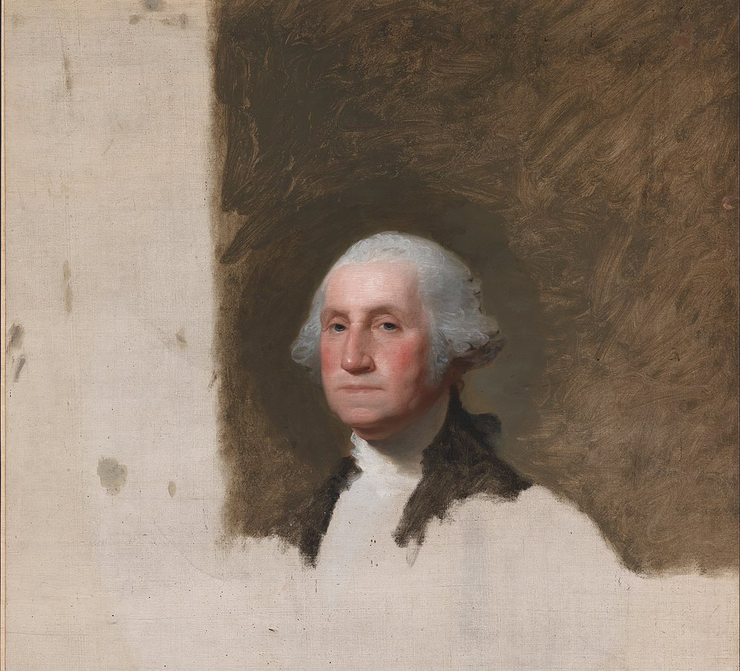
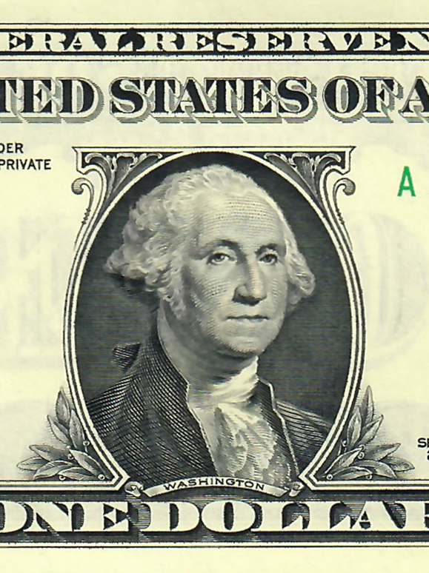
George Washington Portrait
#MDMC26

Slide 35

Unfinished still draws people in…
The Canterbury Tales
#MDMC26

Slide 36
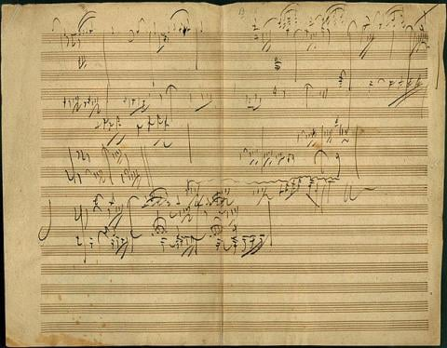
And that’s not the only example
#MDMC26

Slide 37
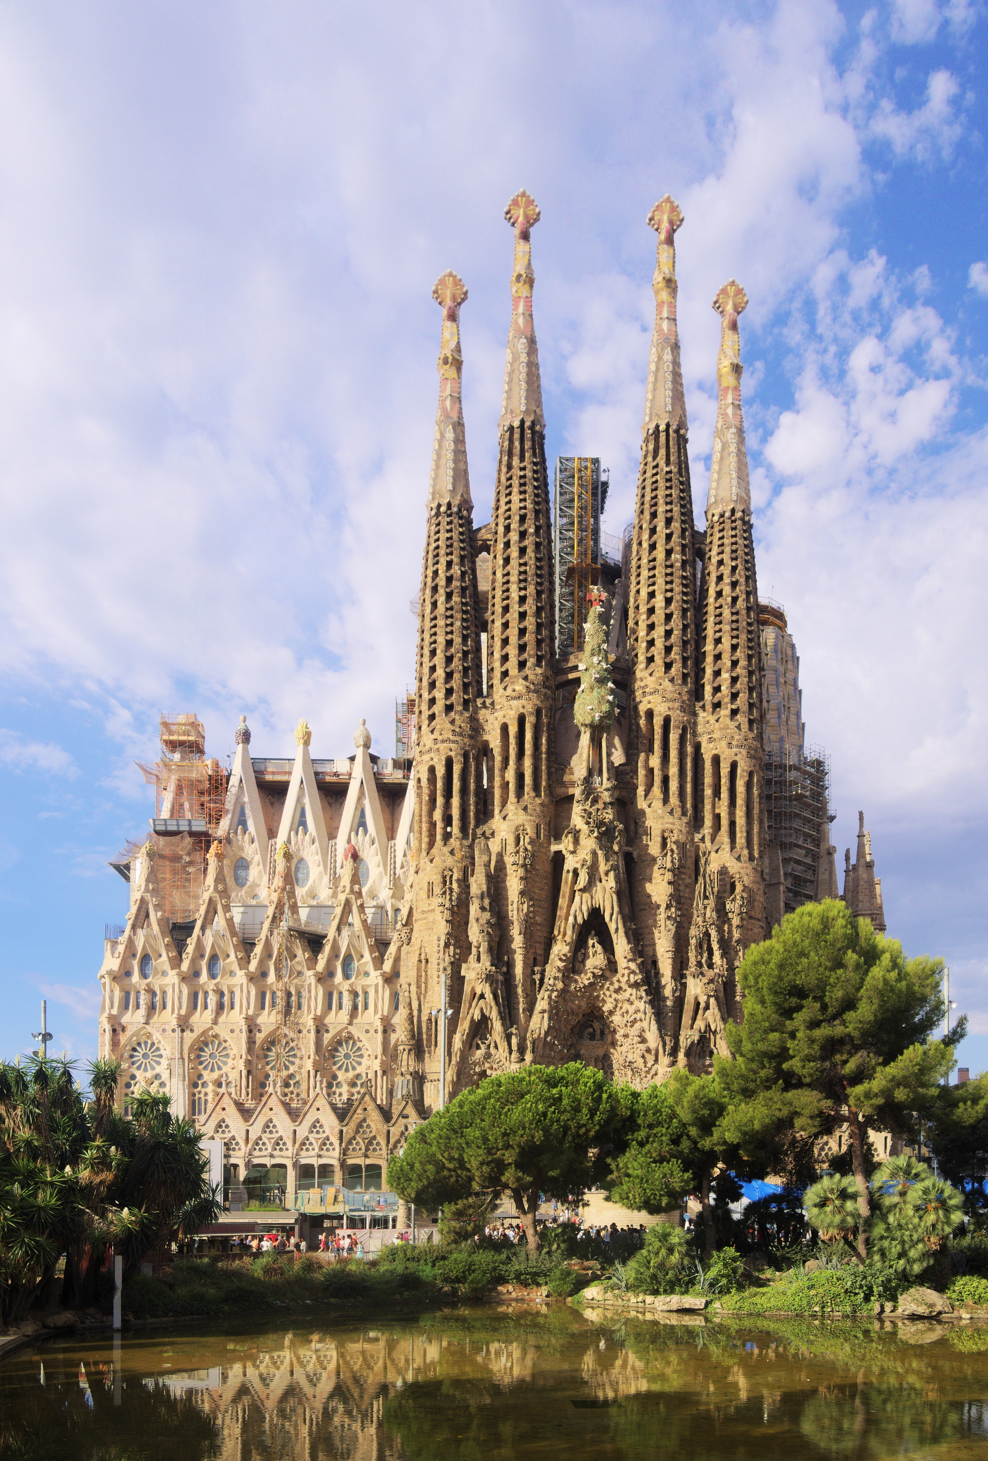
People don’t wait for finished
#MDMC26

Slide 38
The work we admire most isn’t perfect… IT EXISTS
#MDMC26

Slide 39
If perfect isn’t the goal NOW WHAT?
#MDMC26

Slide 40
When you’re stuck, you only have 3 options Quit - Scale – Finish
#MDMC26

Slide 41
Done is a strategy… Not a compromise Done gives you something to improve
#MDMC26

Slide 42
PERFECT IS IMAGINARY Done moves your work forward
#MDMC26

Slide 43
MOMENTUM CREATES BETTER WORK You can’t improve what you haven’t started
#MDMC26

Slide 44
BEFORE YOU LEAVE What is one thing you will finish this week?
#MDMC26

Slide 45
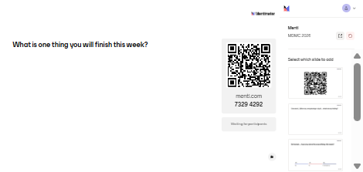
What is one thing you will finish this week?

Slide 46
3 KEY TAKEAWAYS Perfection = decision avoidance Progress requires something imperfect Done creates momentum
#MDMC26

Slide 47
THANK YOU!
Now … Go finish something
@AshleeSang · #MDMC26

